Slide 1

INTRODUCTION TO DATA SCIENCE AND MACHINE LEARNING

Slide 2
Welcome!!
AGENDA OF THE TRAINING
In this course we will try to get essence and insights of data science or to be more specific machine learning.
We will get intuition about what data science is capable of.
We will cover building blocks of data science and to be more specific “MACHINE LEARNING”.

Slide 3
Enablement for you after taking this course
You will apply this understanding in your current project and try to find any pain areas which can be solved using ML.
You will try more complex problems to dig deeper in this field as it is evolving day by day.

Slide 4
Prerequisites
Very basic knowledge of any programing language.
C/C++, java or even pl/sql will work.
Basic linear algebra(linear equations)
Knowledge of Mathematics of high school level will work.
If you are familiar with python, then great else Don’t worry!
If you are not satisfying any of above criteria, No issues, it will not create any problem in understanding this course but for future you will be needing it!!

Slide 5
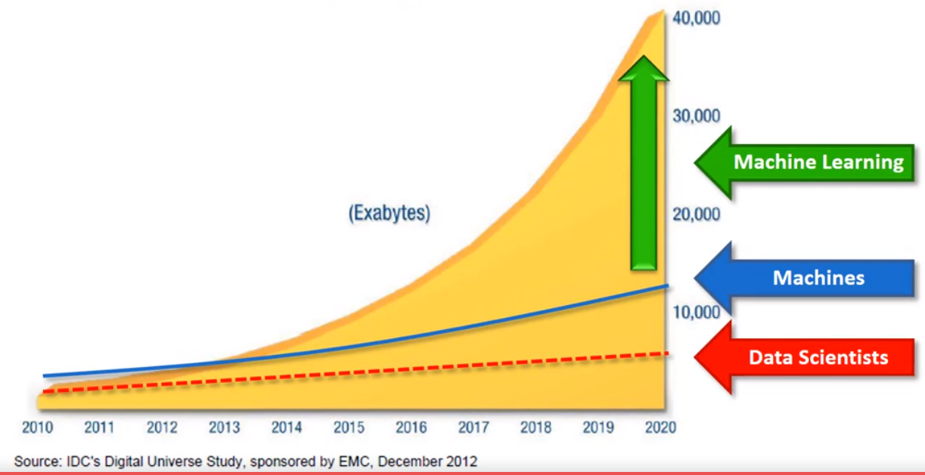
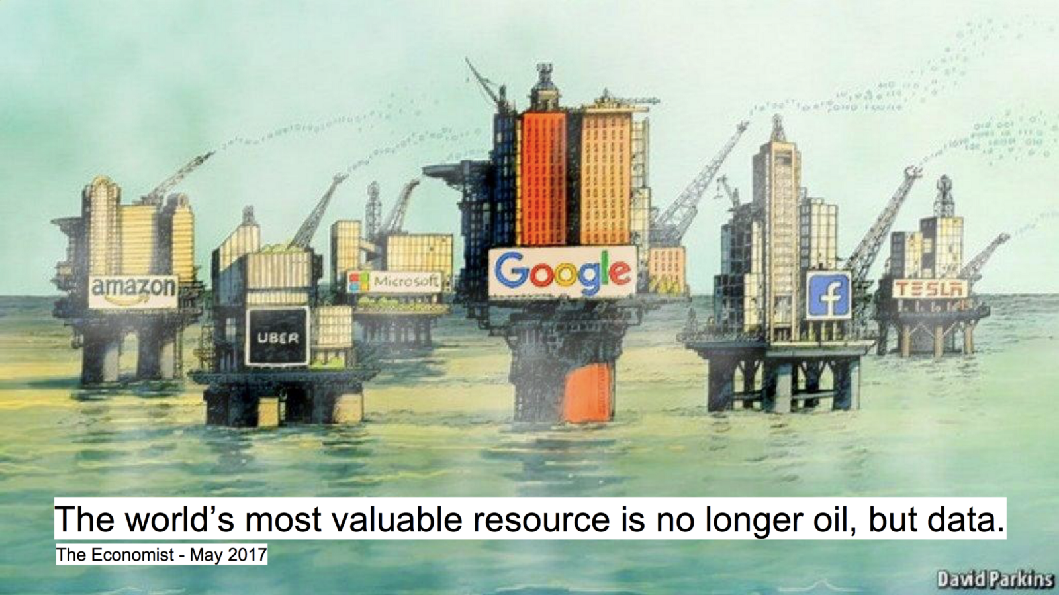
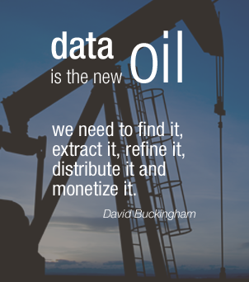
Data: The Driving Force
130 Exabytes till 2005
1200 ExaBytes till 2010
7900 ExaBytes till 2015
40900 ExaBytes till 2020

Slide 6
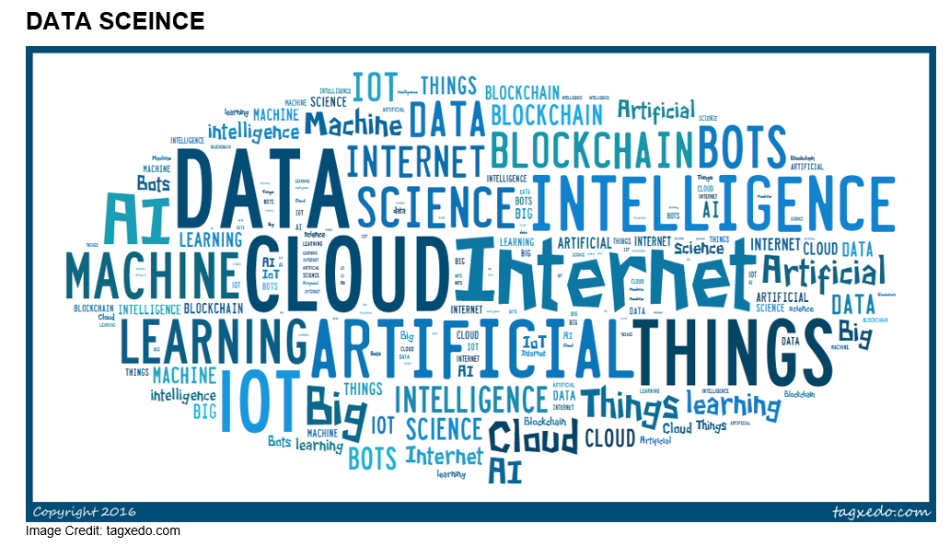

Slide 7
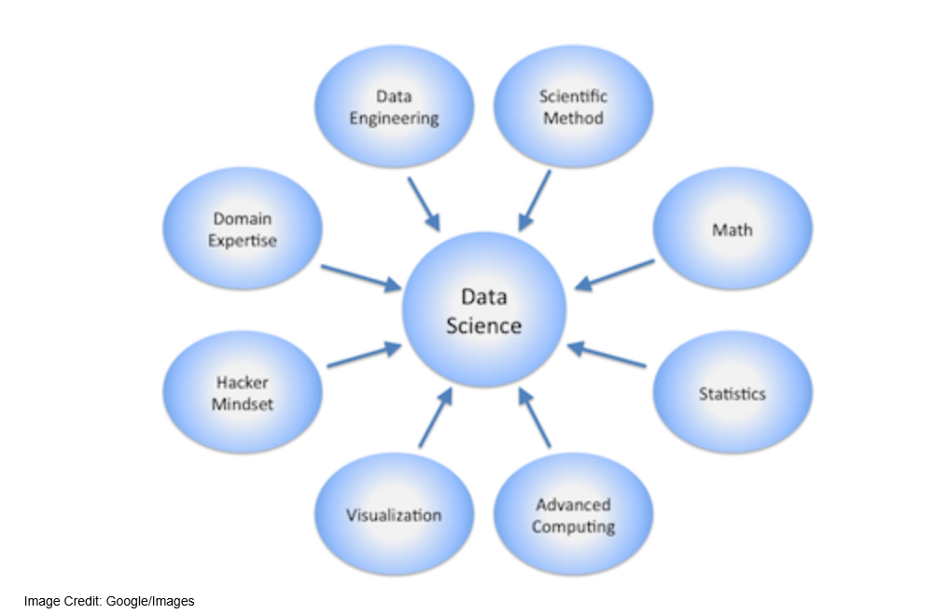

Slide 8
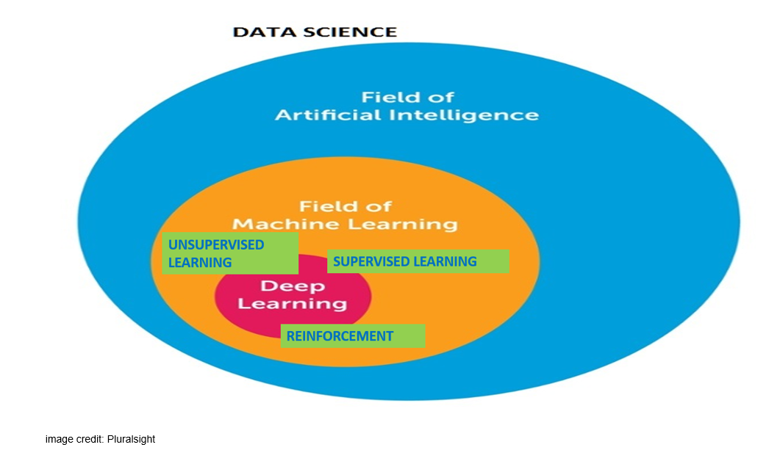

Slide 9
Machine learning
Use of data to make a machine make intelligent decision
Machine learning is nothing but to recognize patterns in your data.
According to Arthur Samuel way back in 1959: “[Machine Learning is the] field of study that gives computers the ability to learn without being explicitly programmed.”
An important task of a Machine learning engineer in his/her work life is to extract, process, define, clean, arrange and then understand the data to develop intelligent algorithms.

Slide 10

Application of Machine Learning
Fraud Detection

Slide 11
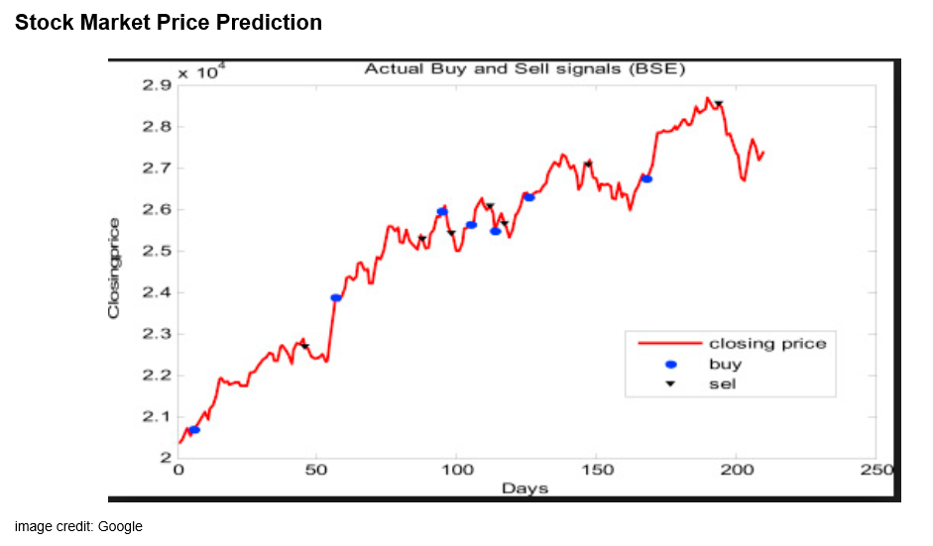

Slide 12
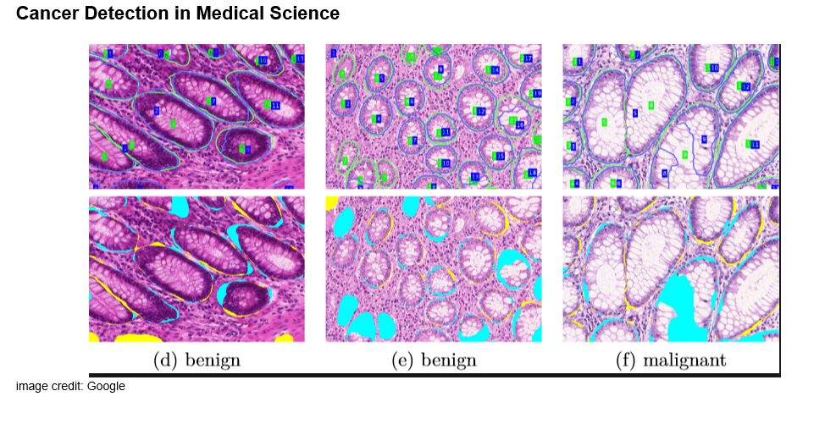

Slide 13


Slide 14
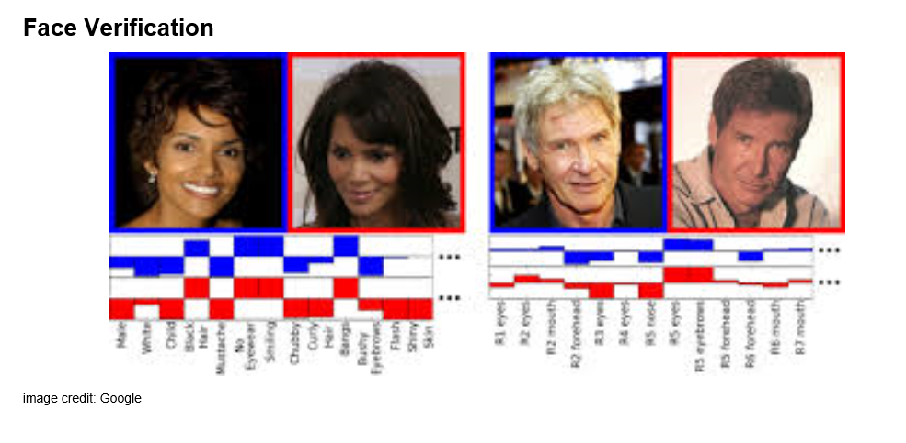

Slide 15
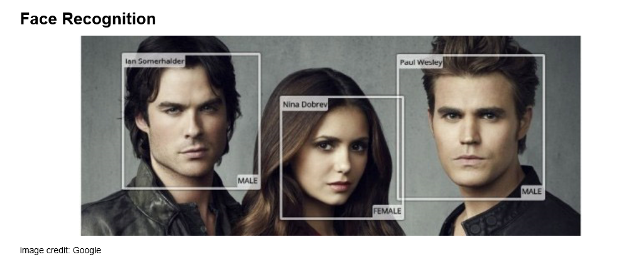

Slide 16


Slide 17
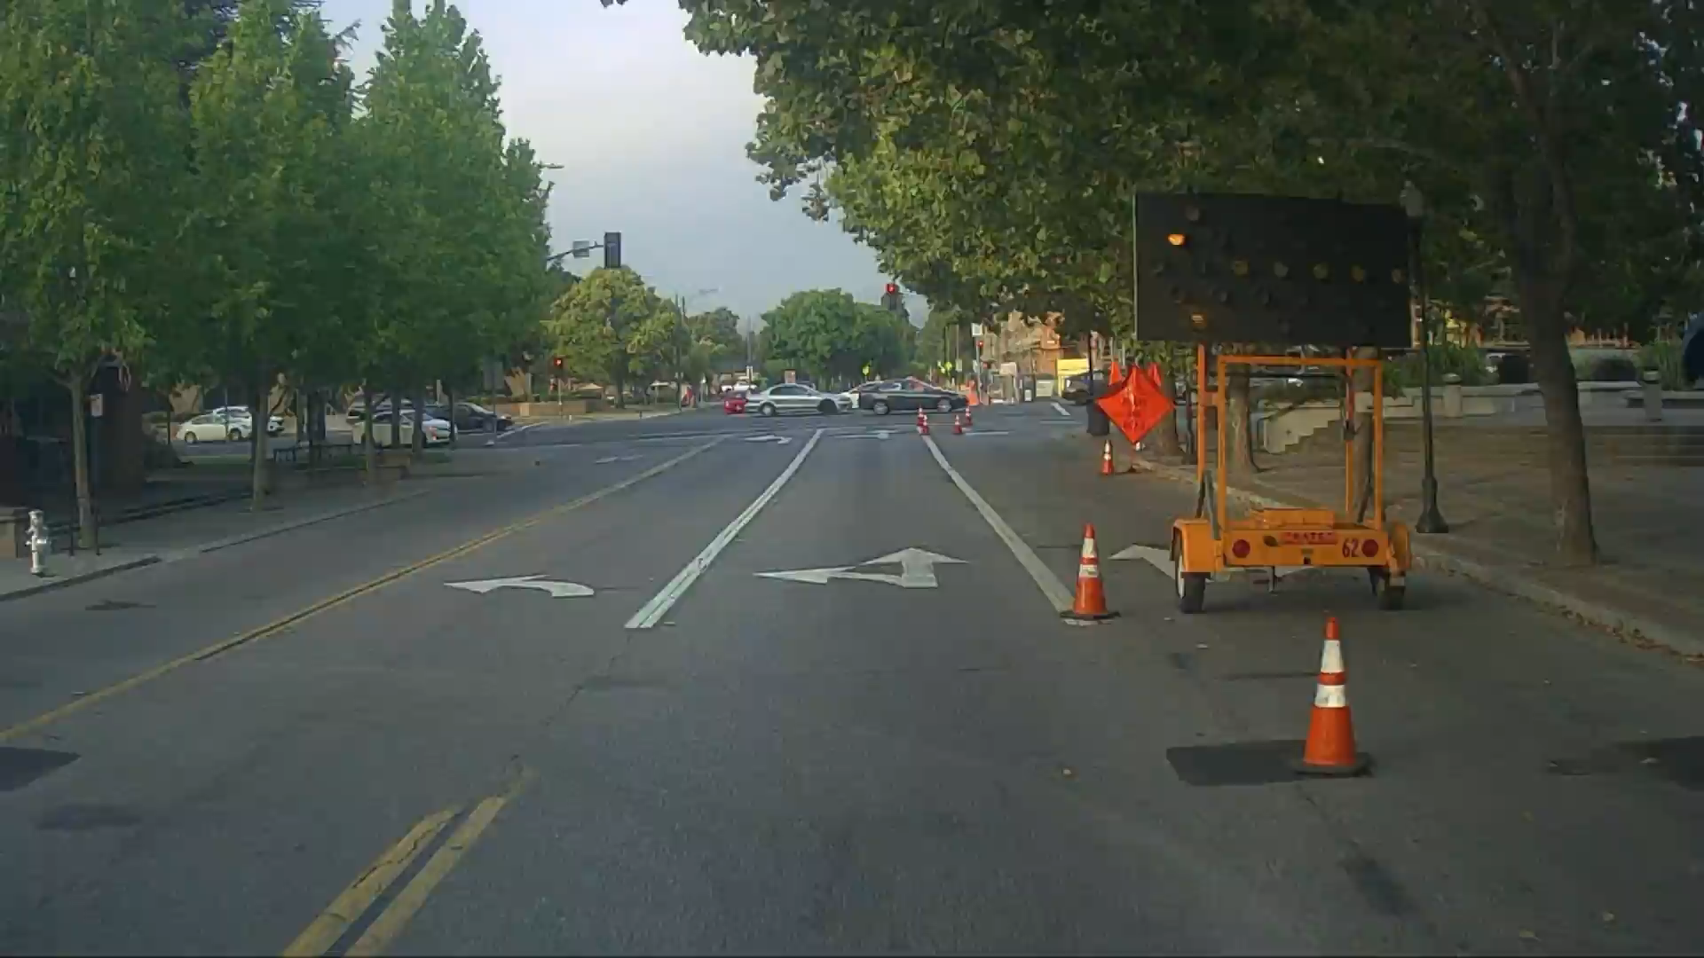
Autonomous Driving
How you sees while being on driving seat

Slide 18
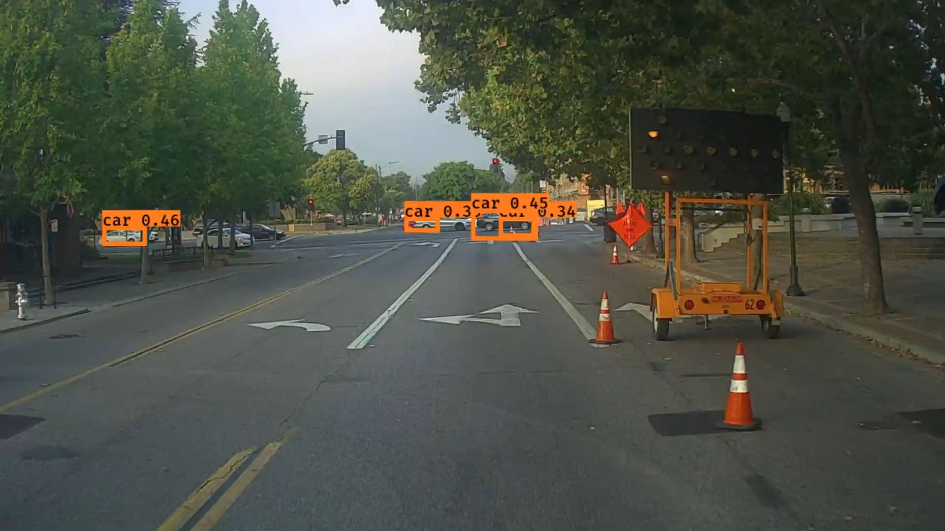
How machine sees while being on driving seat

Slide 19
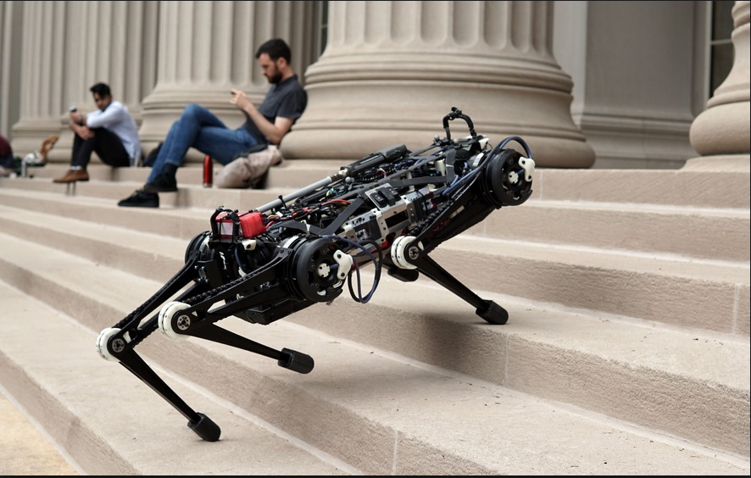
Robot Dog

Slide 20
Links for application of Machine Learning
https://youtu.be/W1LWMk7JB80
https://youtu.be/qv6UVOQ0F44

Slide 21
Course Overview
Why Python
Tools and installation
A Word on Jupyter Notebook
Python
Machine Learning
Types Of Machine Learning
Supervised Learning
Data Science Project Cycle
Data Pre Processing
Missing Values
Categorical Features
Feature Engineering.
Algorithms
Cross Validation
Normalization (Advance)
Metrics
Under & Over Fitting (Advance)
Regularization (Advance)
Hyper Parameter (Advance)
Visualizations

Slide 22
Why Python
it’s easy to understand.
Packages, Packages everywhere !
Huge Community Support
You can work with all kind of data
MATLAB/R/Octave/Python
MATLAB-Slow, can only be used in prototyping, not open source
R-Open Source, for statistical analysis
it’s not fast and takes more space

Slide 23
Tools and Installation
You can download python from website https://www.python.org/downloads/
At time of this training stable released version is 3.7
I will suggest to use 3.6 for now
But for our purpose we will be using Anaconda distribution.
It is open source distribution for Python and R for DS and ML.
You can download it from website “https://www.anaconda.com/download/”
Right now they are providing 3.7 but you can switch to python 3.6 as well.
***Step by step installation of anaconda
https://www.datacamp.com/community/tutorials/installing-anaconda-windows
https://medium.com/@GalarnykMichael/install-python-on-windows-anaconda-c63c7c3d1444
https://docs.anaconda.com/anaconda/install/windows/

Slide 24
A word on Jupyter Notebook
Jupyter Notebook?
Open source web application
Very good in prototyping phase
Individual blocks
Flexible, sharable
Allow python, SQL, R, Julia
Jupyter Basics (refer Notebook)

Slide 25
Python
It is a general purpose programing language.
Python is a high level language.(in terms of CPU time, it is not very effective)
User friendly and easy to interpret.
War of python 2.x vs 3.x(python 3 is around from 2008).
95% data science libraries migrated to 3.x
No support of python 2.x after 2020.
Lets Start some coding.(refer Python Notebook)

Slide 26
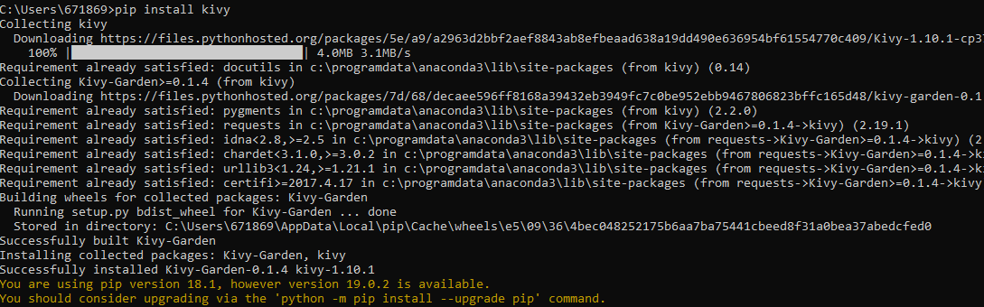
PIP & conda
pip is a recursive acronym for "Pip Installs Packages“
pip is a package management system used to install and manage software packages written in Python.
conda installs any package in conda environments
Packages can be installed from command prompt as well as from jupyter notebook. Please follow below link if you want extra information:- https://jakevdp.github.io/blog/2017/12/05/installing-python-packages-from-jupyter/

Slide 27
Data in Machine Learning
Training Data
Independent Variable
Dependent variable
Test Data
Independent Variable
Model will be trained with Training data
Performance will be checked on validation data
Results will be predicted for test data
Training set (80%-90% of total data
Validation set (10%-20% of total data

Slide 28
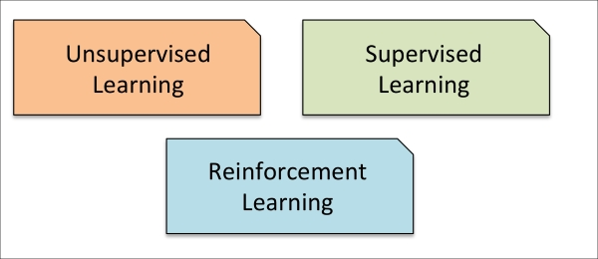
Types Of Machine Learning

Slide 29
Supervised Learning
Ultimate goal is to develop a finely tuned predictor functions.
Supervised machine learning: The program is “trained” on a pre-defined set of “training examples”, which then facilitate its ability to reach an accurate conclusion when given new data.
It is mainly if two types:
Regression
Classification (We will solve problem on this)

Slide 30
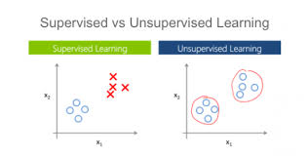
Unsupervised Machine Learning
Unsupervised Learning is a class of Machine Learning techniques to find the patterns in data.
Unsupervised learning is a group of
machine learning algorithms and
approaches that work with this
kind of “no-ground-truth” data.
https://medium.com/@gowthamy/machine-learning-supervised-learning-vs-unsupervised-learning-f1658e12a780
CATS
DOGS
What is it?

Slide 31
Reinforcement Learning
It is about taking suitable action to maximize reward in a particular situation
Reinforcement learning is an important type of Machine Learning where an agent learn how to behave in a environment by performing actions and seeing the results.
It doesn’t require any training data.
It works on idea of reward and penalty in given environment
More Learning:- https://medium.freecodecamp.org/an-introduction-to-reinforcement-learning-4339519de419

Slide 32
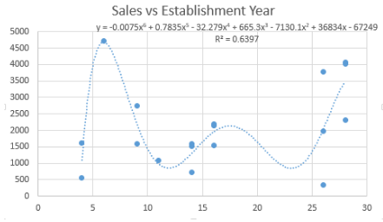
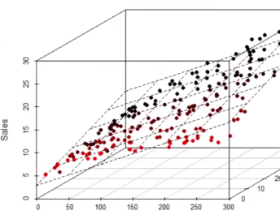
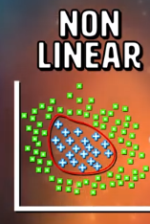
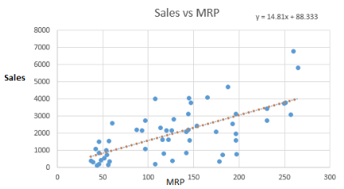
Regression
Simple Regression
Multiple Regression
Linear
Non Linear
Linear
Non Linear

Slide 33
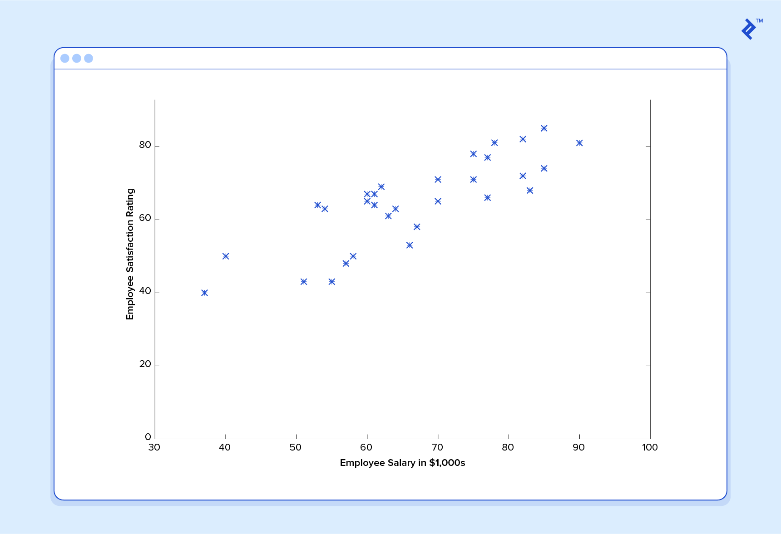
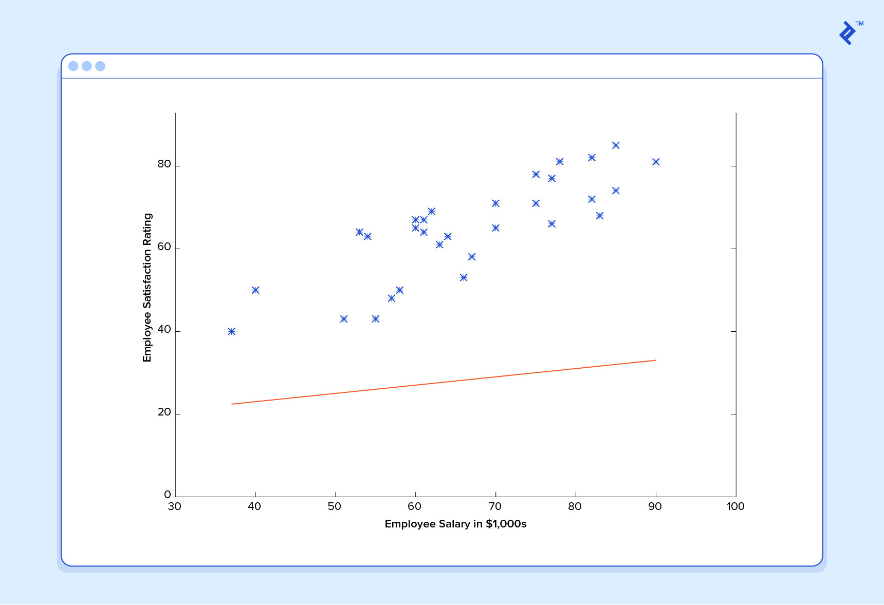
Supervised Machine learning Example(Regression)

Slide 34
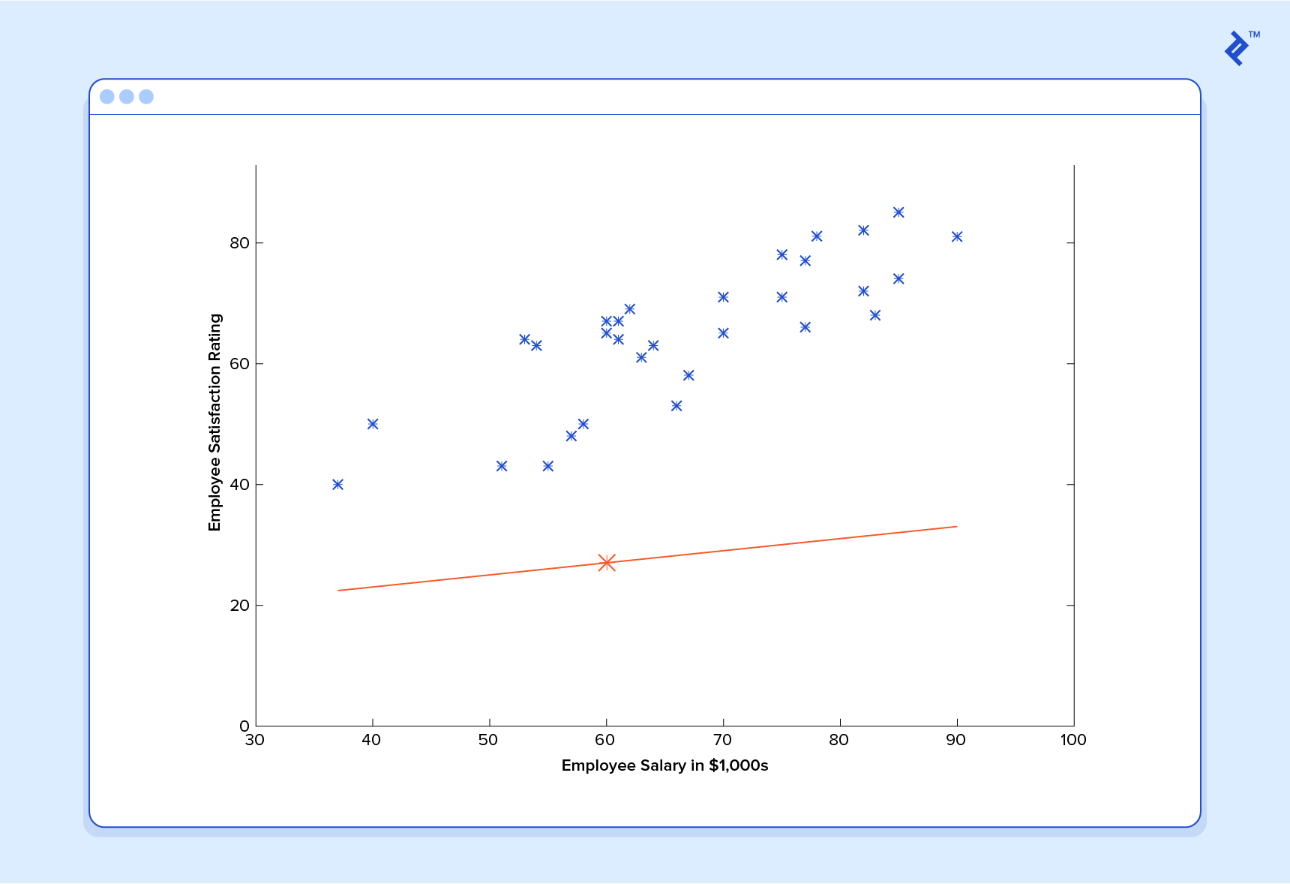
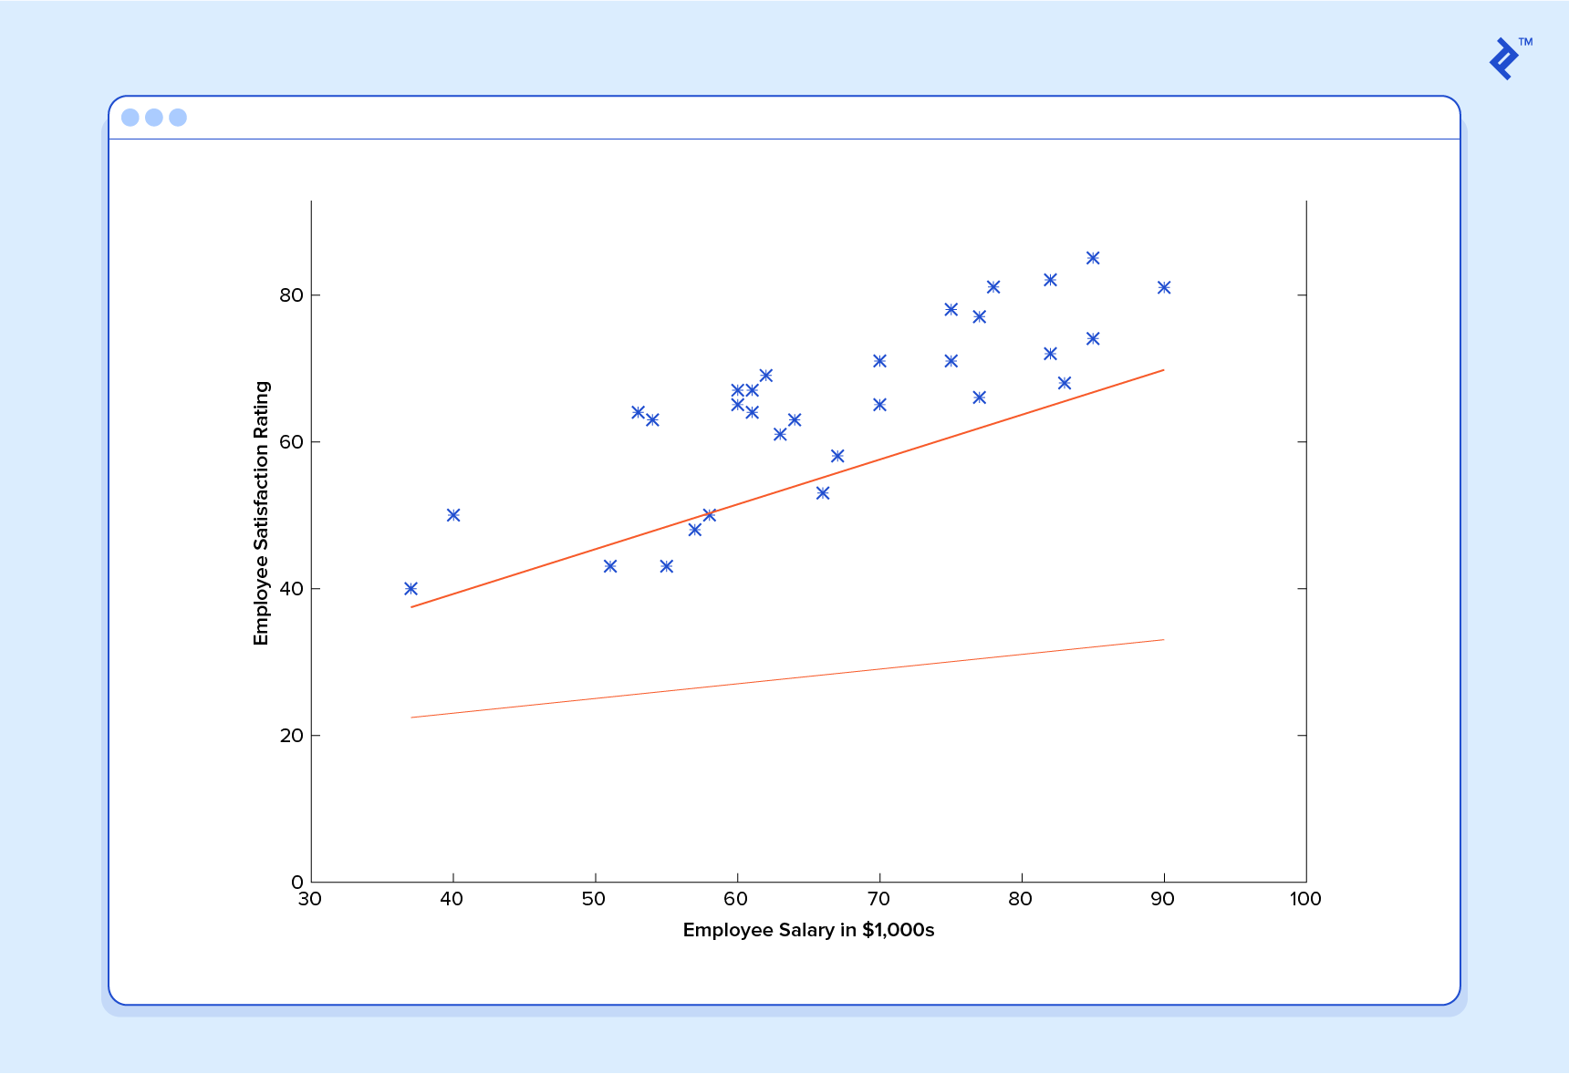
Contd..
Suppose we asked from this predictor function to predict satisfaction index of employee with salary 60k,
And It will give us result as 27, which is totally wrong

Slide 35
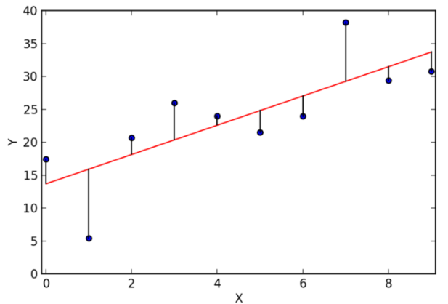
Contd..
Predictor/model will try to reduce total distance to that line.
It can be done many methods but most important is.
>Gradient Descent

Slide 36
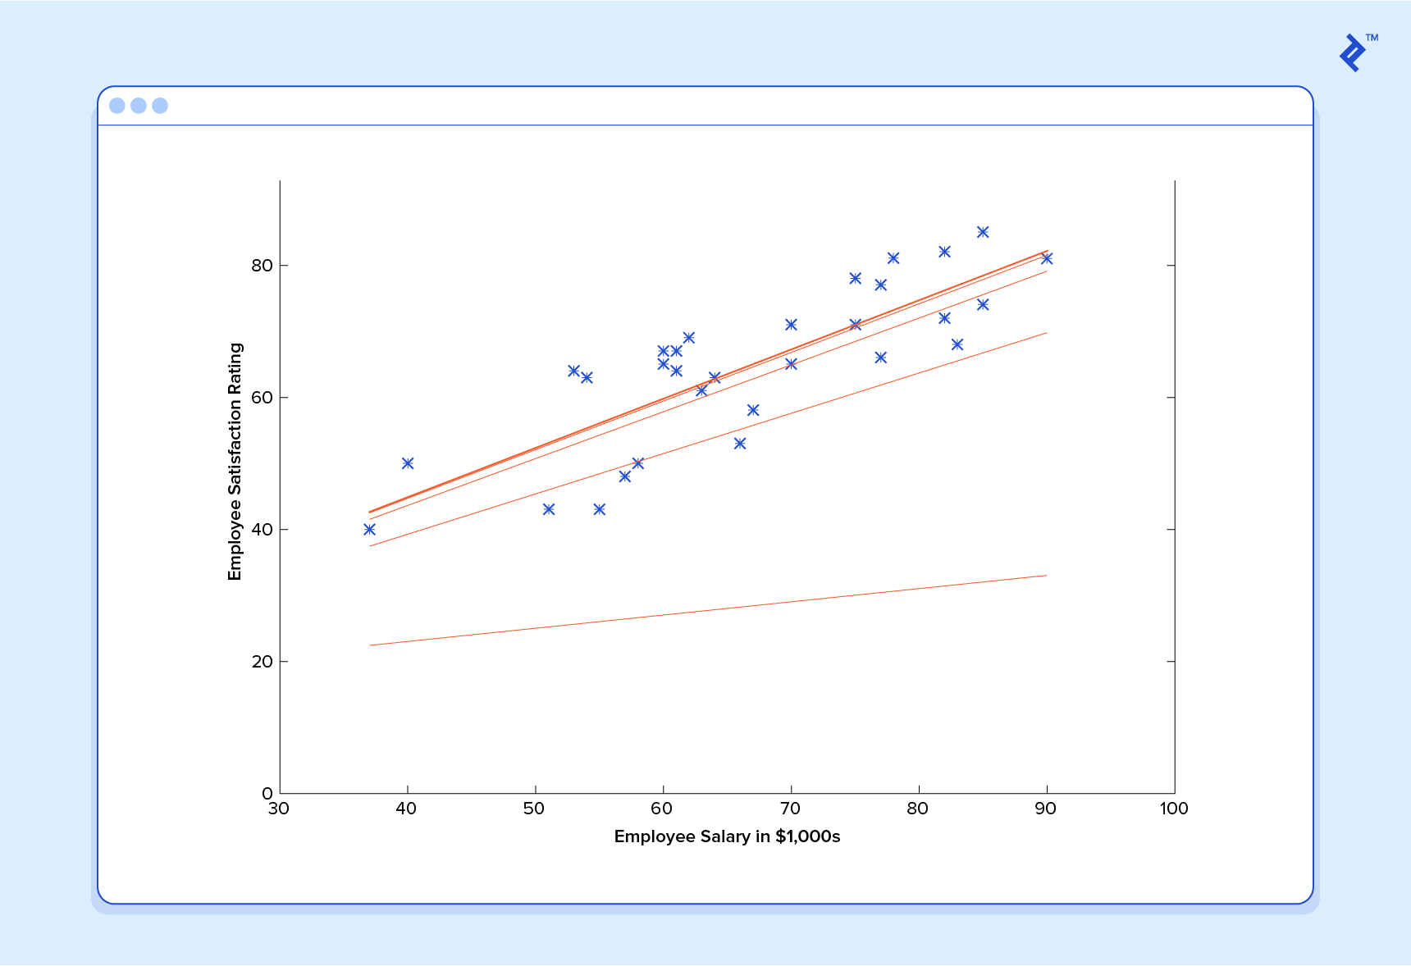
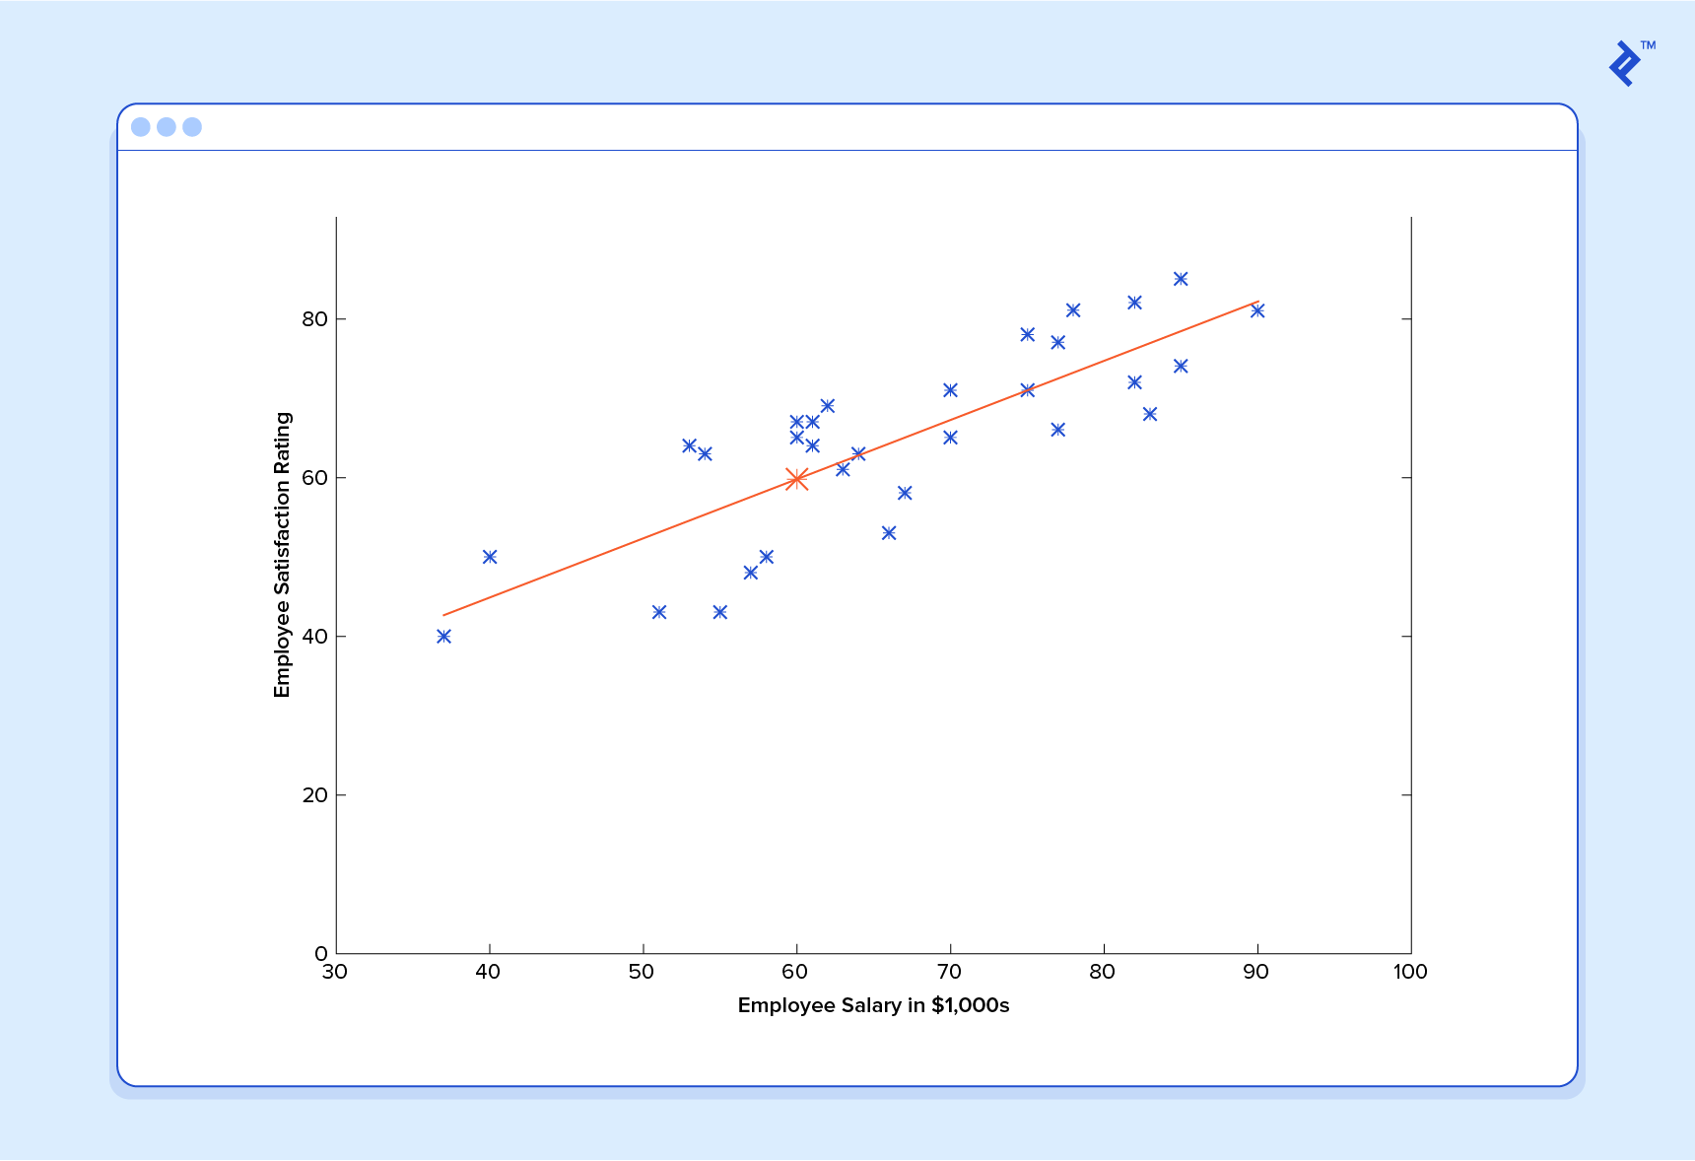
Contd..
Now we asked our predictor to predict value for salary 60k.
And we got result roughly as 60, which is somewhere near to our correct value.

Slide 37
Contd..
This function takes input in four dimensions and has a variety of polynomial terms. Deriving a normal equation for this function is a significant challenge. Many modern machine learning problems take thousands or even millions of dimensions of data to build predictions using hundreds of coefficients

Slide 38
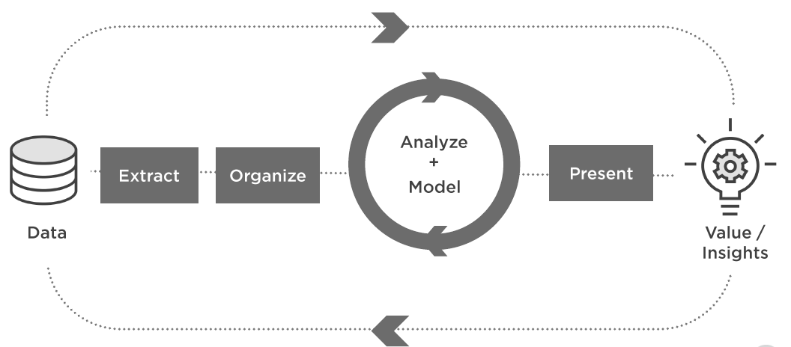
DATA SCIENCE PROJECT CYCLE
https://medium.com/bright-minds-analytica/data-science-machine-learning-project-life-cycle-aa06d9cfc33d

Slide 39
Problem Statement
A bank ABC wants to forecast which customer will stay with bank and who will leave the bank. It has extracted all possible details about the customer and wants from you create a model/predictor so that they can use it whenever they want. They will using this model to predict the possibility of a customer of leaving the bank. By knowing these details they will take extra precaution and try to improve customer relationship for those customers.
Files provided: train.csv,test.csv
Features/columns provided:
CustomerId :Unique id of the customers
Surname :Surname of the customers
CreditScore : credit score of the customer( 1 to 1000)
Geography : Geography from which customer belongs
Gender : Gender of customer(Female/Male)
Age :Age of Customer( 1 to 100)
Tenure : Duration from which customer is part of the bank( in years)
Balance: Current balance of the customers
HasCrCard: if customer has credit card from this bank or not(1:yes,0:No)
IsActiveMember : If customer is active member or not(1 :active,0:not active)
EstimatedSalary :Estimated salary of the customer( or income of customer)
Exited : (1:Stayed, 0:left)

Slide 40
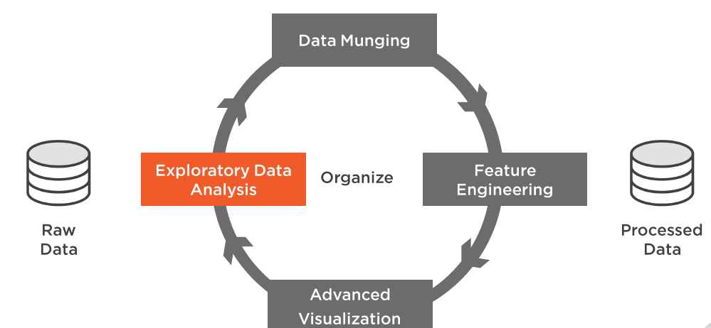
Data Pre processing
Get the dataset
Importing the libraries
Importing the dataset
Data Exploration
Missing data
Outliers Detection
Categorical data
Feature scaling
Splitting data in train and test

Slide 41
Data Exploration
Numerical features
Categorical features
Distributions
grouping
https://medium.com/district-data-labs/data-exploration-with-python-part-1-643fda933479

Slide 42
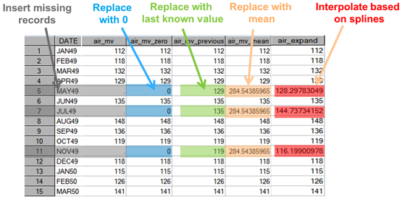
Missing Values
Missing Values
Value not known
Can be represented as NaN
Very common in real world
Non availability of data
Manual data entry mistake
Measuring error
Solution
Deletion
Imputation
https://towardsdatascience.com/handling-missing-values-in-machine-learning-part-1-dda69d4f88ca

Slide 43
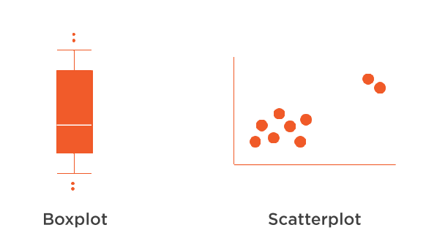
Outliers
Outliers
Different from normal data
Either very low or very high from average behavior of that variable
Source
Data Entry
Natural
Exception
Issue
Biased analysis
Solution
Removal
Transformation
Binning
Imputation
https://medium.com/datadriveninvestor/unboxing-outliers-in-machine-learning-d43fe40d88a6

Slide 44
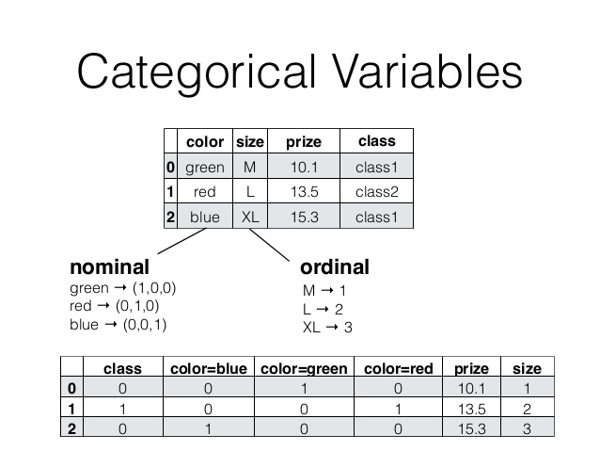
Categorical Features/Data
One Hot Encoding

Slide 45
Feature Engineering
Addition of new features/columns for better prediction
Transforming data to better representative features
It needs great domain expertise to create new features
It needs very depth insight of data to create new features
Don’t create new features as it can back fire, if you inserted correlated feature.
https://medium.com/@mehulved1503/feature-selection-and-feature-extraction-in-machine-learning-an-overview-57891c595e96

Slide 46
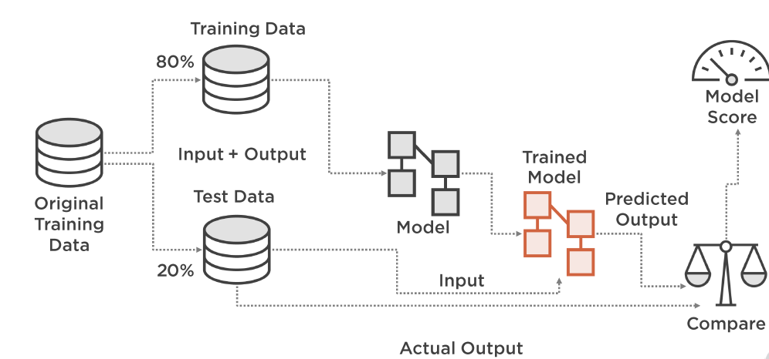
Cross Validation
Cross-validation is a technique for evaluating ML models by training several ML models on subsets of the available input data and evaluating them on the complementary subset of the data
https://towardsdatascience.com/why-and-how-to-cross-validate-a-model-d6424b45261f

Slide 47
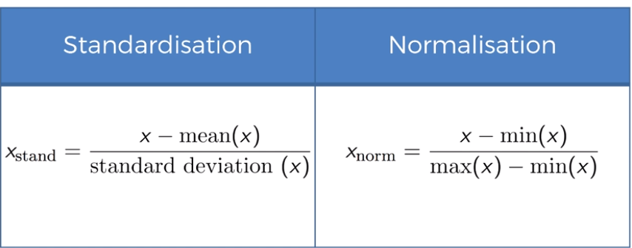
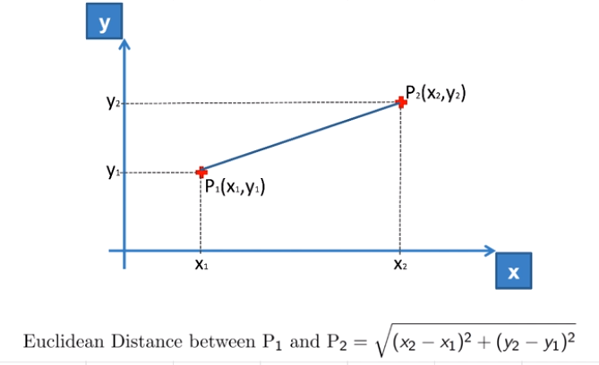
Feature Normalization
Features can be normalized in
mentioned two ways.
https://medium.com/greyatom/why-how-and-when-to-scale-your-features-4b30ab09db5e

Slide 48
Algorithms
Logistic Classifier
K Nearest Neighbors Classifier
Random Forest Classifier
Naive Bayes Classifier
Support Vector Machine Classifier
XG Boost Classifier
CatBoost Classifier
https://medium.com/greyatom/a-trip-to-random-forest-5c30d8250d6a
https://medium.com/@srishtisawla/introduction-to-naive-bayes-for-classification-baefefb43a2d
https://medium.com/coinmonks/support-vector-machines-svm-b2b433419d73
https://medium.com/greyatom/logistic-regression-89e496433063
https://www.analyticsvidhya.com/blog/2018/09/an-end-to-end-guide-to-understand-the-math-behind-xgboost/

Slide 49
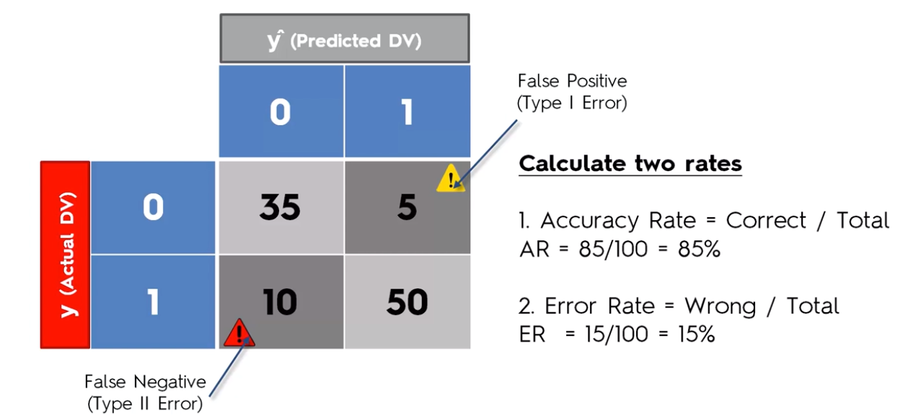
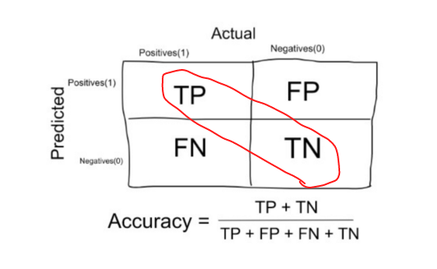
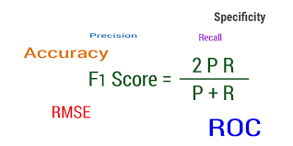
Metrics
These are metrics which rate our model. Using these we can come to conclusion either we need more tuning or we have reached threshold and is it good enough to deploy in production.
https://towardsdatascience.com/metrics-to-evaluate-your-machine-learning-algorithm-f10ba6e38234

Slide 50
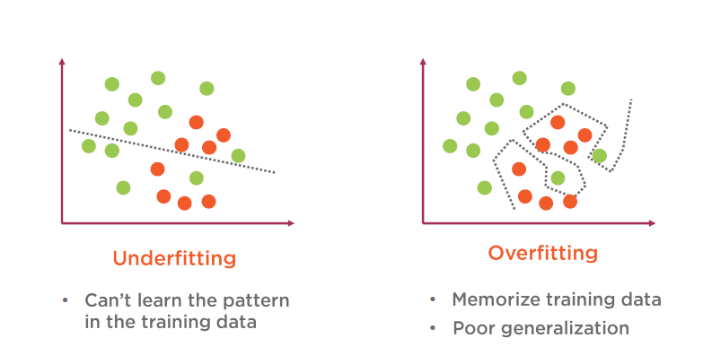
Under Fitting vs Over Fitting
https://medium.com/greyatom/what-is-underfitting-and-overfitting-in-machine-learning-and-how-to-deal-with-it-6803a989c76

Slide 51
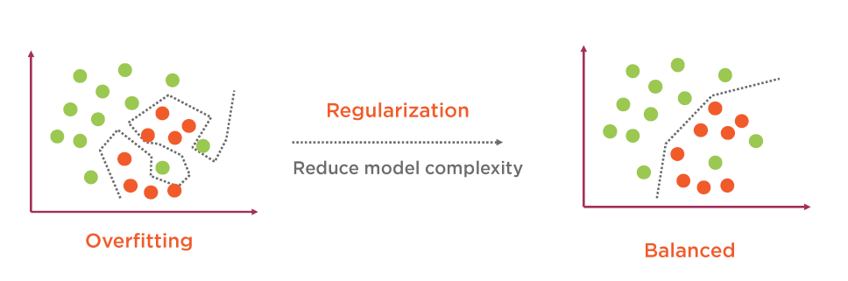
Regularization
https://towardsdatascience.com/regularization-in-machine-learning-76441ddcf99a

Slide 52
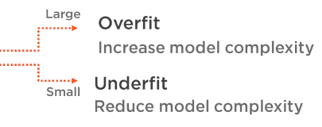

Hyper parameter Tuning
After processing all steps and selecting the model there is a scope of tuning your model a bit more.
It can be done by tuning the parameters which we paas to the model.
LogisticRegression(C=1.0, class_weight=None, dual=False, fit_intercept=True,intercept_scaling=1, max_iter=100, multi_class='ovr', n_jobs=1,penalty='l2', random_state=None, solver='liblinear', tol=0.0001,verbose=0, warm_start=False)
https://medium.freecodecamp.org/an-introduction-to-high-dimensional-hyper-parameter-tuning-df5c0106e5a4

Slide 53


Slide 54
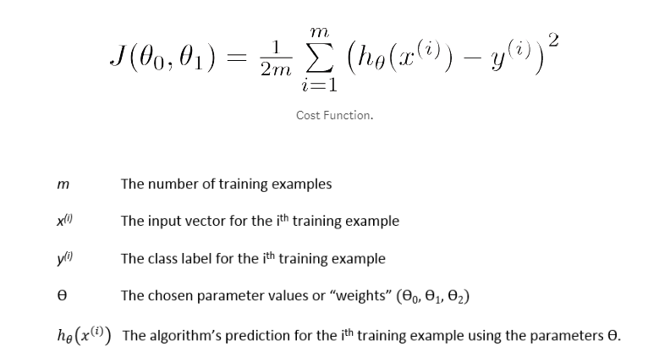
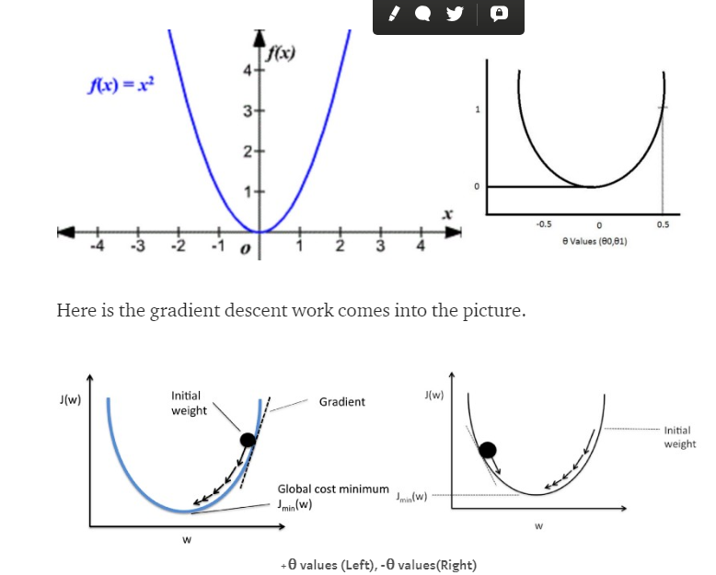
Extra Topic: Gradient Descent

Slide 55
Appendix 1 :Link to follow for Learning
https://www.kaggle.com/learn/overview
https://www.kaggle.com/learn/python
https://colab.research.google.com/
https://blog.paperspace.com/
https://medium.com
https://github.com/
https://www.analyticsvidhya.com/
https://www.analyticsindiamag.com/
https://www.youtube.com/watch?v=YYXdXT2l-Gg&list=PL-osiE80TeTt2d9bfVyTiXJA-UTHn6WwU
https://www.youtube.com/channel/UCWN3xxRkmTPmbKwht9FuE5A
https://www.youtube.com/channel/UCXZCJLdBC09xxGZ6gcdrc6A
https://www.youtube.com/channel/UCOjD18EJYcsBog4IozkF_7w
https://www.youtube.com/channel/UCH6gDteHtH4hg3o2343iObA
https://www.youtube.com/channel/UCfzlCWGWYyIQ0aLC5w48gBQ

Slide 56
THANK YOU!!!

